Slide 1


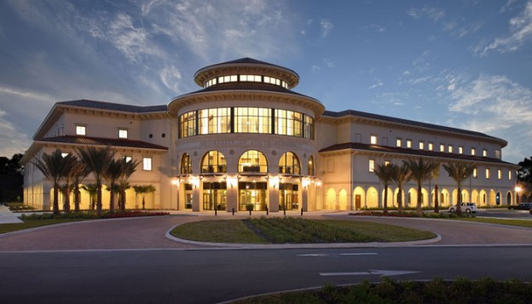
Week- Agile ISM 6930 – 3 Credit Hours Special Topics (Agile Project Management - APM) Spring, 2018; Room: A205 (12:00pm to 2:45pm) Dr. Bhuvan UNHELKAR IT Faculty, College Of Business; Office: C225; bunhelkar@sar.usf.edu; 941-359-4654

Slide 2
Week- Agile ISM 6930 – 3 Credit Hours Special Topics (Agile Project Management - APM) Spring, 2018; Room: A205 (12:00pm to 2:45pm) Dr. Bhuvan UNHELKAR IT Faculty, College Of Business; Office: C225; bunhelkar@sar.usf.edu; 941-359-4654

Slide 3

Agenda
The
"Agile job aids" (Selected Agile Practices).
Study of Agile Practice :
Summary & Consolidation

Slide 4

Sub-Module W
A
© MethodScience; Material Designed and Presented by Dr. B. Unhelkar; drawn from The Art of Agile Practice

Slide 8
Sub-Module W
A
© MethodScience; Material Designed and Presented by Dr. B. Unhelkar; drawn from The Art of Agile Practice

Slide 12
Sub-Module W
A
© MethodScience; Material Designed and Presented by Dr. B. Unhelkar; drawn from The Art of Agile Practice

Slide 16
Sub-Module W
A
© MethodScience; Material Designed and Presented by Dr. B. Unhelkar; drawn from The Art of Agile Practice

Slide 20
Sub-Module W
A
© MethodScience; Material Designed and Presented by Dr. B. Unhelkar; drawn from The Art of Agile Practice

Slide 24
Sub-Module Agile Job Aids
And a Discussion Question
© MethodScience; Material Designed and Presented by Dr. B. Unhelkar

Slide 25


Slide 26
Sub-Module Agile Teams
Cross-Functional; Co-Located;
© MethodScience; Material drawn from The Art of Agile Practice (B. Unhelkar)

Slide 27

Team-Awesome (OzAir – Project: Airline Booking System -ABS)
Evan Barniskis
Hasena “Stacy” Dukhi
Mary Helmle
John Holdway
Joel Lengyel

Slide 28
Team-Best (Desi Travels: Project – Travel Management System - TMS)
Michael Myers
Christopher Nothdurft
Nikki Orth
A Zahidur Rahman

Slide 29
Team-Champions (Lucky Insurance: Project – Insurance Management System - IMS)
Stanley Abada
Rafael Adames
Sumner Darling
Yves Lexis
Mark Richman

Slide 30
Conclusions & Future Directions
We discussed…??
Do you see what we see?

